Slide 1

Project 3 Data Engineering
Amadou Diallo
Ibraam Masoud
Toni Akunda
Kyle Faulkner

Slide 2
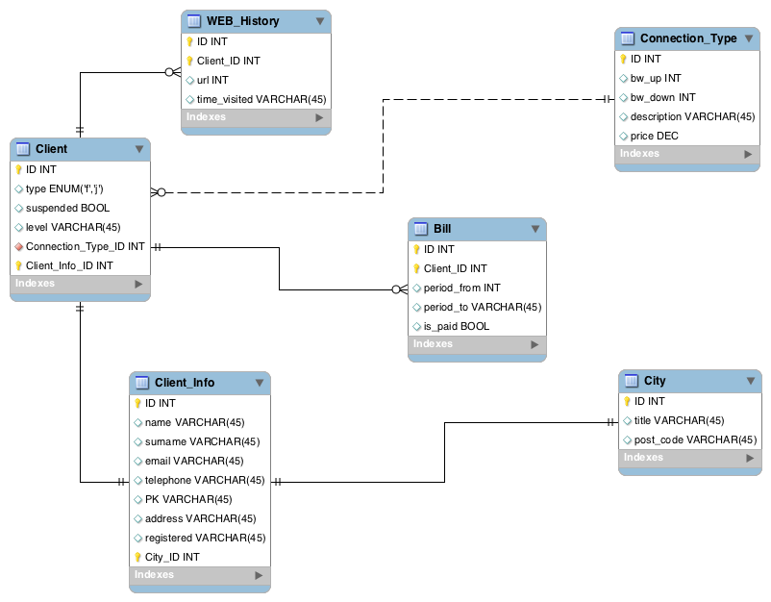
Database Setup
Normalization Form : Third Normal Form
Key Benefits of 3NF:
Minimizes Data Redundancy: Reduces repetition by removing unnecessary duplicate data.
Improves Data Integrity: Ensures consistency by eliminating anomalies (update, insertion, deletion).
Prevents Anomalies: Eliminates issues related to inconsistent or redundant data entries.
Easier Maintenance & Scalability: A well-organized schema makes future updates and scaling more manageable.
Potential Drawbacks:
Complex Queries: More tables require more joins, potentially complicating queries and reducing performance.
Over-Normalization: Excessive decomposition may lead to overly complex schema and unnecessary complexity.
Performance Trade-offs: Slower read operations due to multiple joins in large datasets.
Increased Development Effort: Requires more effort to design and manage the schema.
When to Use 3NF:
Ideal for transactional systems where data consistency, integrity, and reducing redundancy are priorities.
Not always the best for read-heavy applications that prioritize performance over structure.

Slide 3
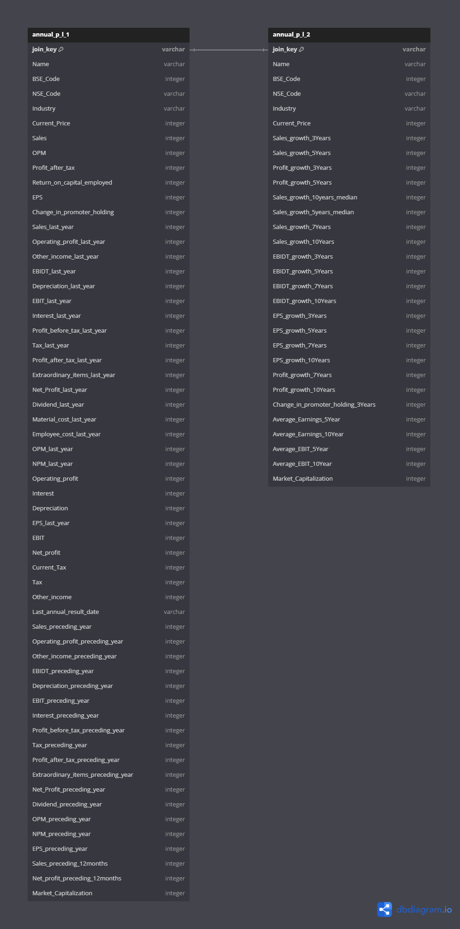
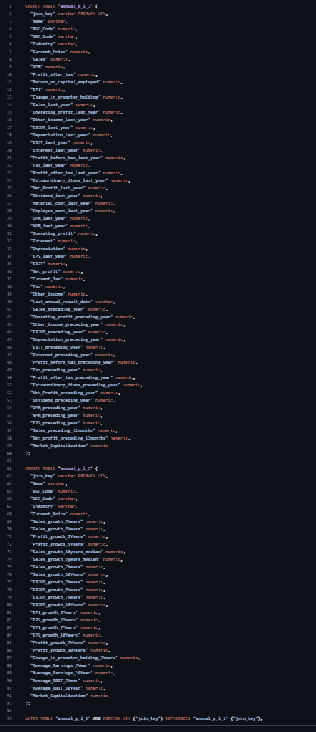

ERB Output Diagram
ERD SQL Table Creation
Database Tool Used
pgAdmin

Slide 4
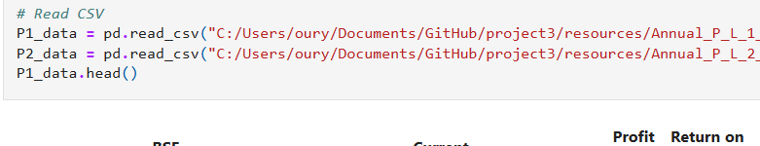
Reading in the Data & Data Transformations
We read in the data using pandas and then converted it into a DataFrame
We then did several transformations. For example:
We split columns
Moved columns around
Created if statements based on the data
We performed calculations on the data and put the results in a different column
Lastly, we filtered the entire table based on a specific column

Slide 5
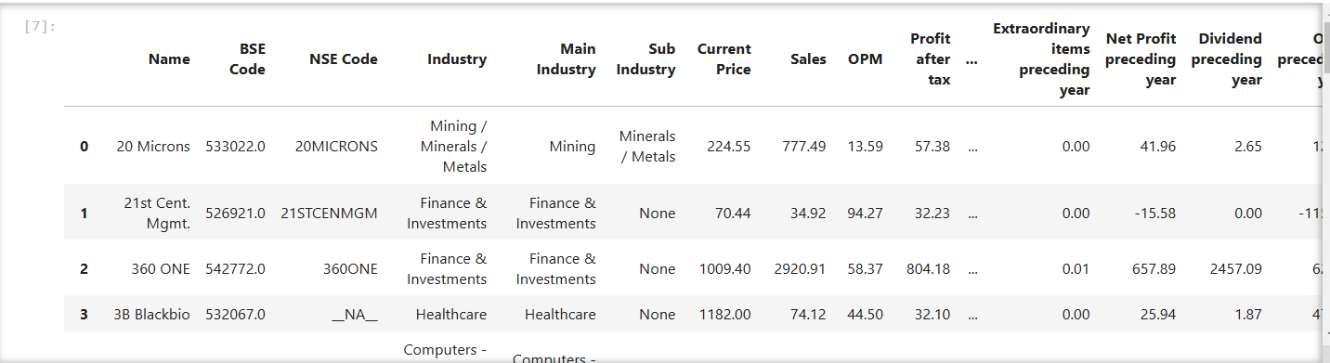
Splitting the Columns
We split the Industry column into 2 columns.
As you can see, we broke it down into “Main” and “Sub” industry whenever there was a sub industry
Also, when the columns were split, they were at the end of the table, so we also moved the 2 columns to be next to Industry

Slide 6
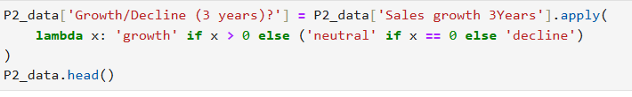
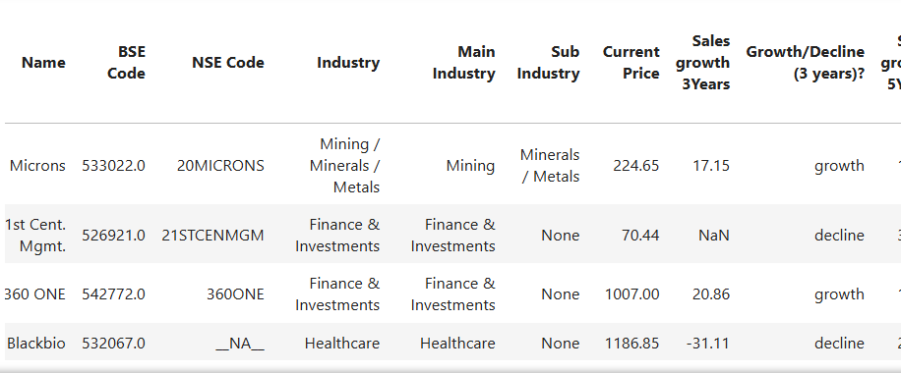
Creating If Statements
We used the if statement to create a column that shows whether there was a growth or decline for the past 3 years in sales as you can see in
If the number was positive, it would say growth
If the number was negative, it would say decline

Slide 7
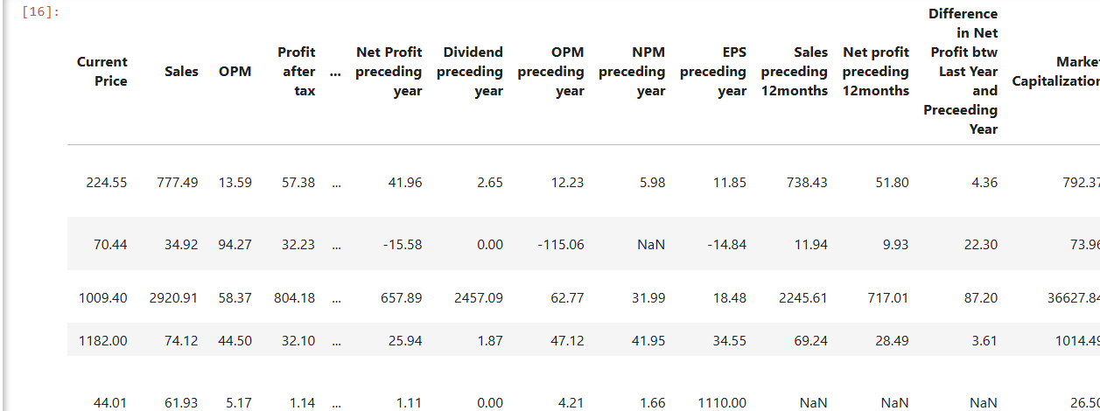
Performed Calculations
We used a calculation to see what the difference was between last year’s net profit and the proceeding year’s net profit to determine whether it was a positive growth or if the company lost money
As you can see here most were positive, but some were negative numbers, meaning the company did more poorly last year compared to the previous year

Slide 8
Filtering the Table
Lastly, we used this code above that looks at the “Difference in Net Profit btw Last Year and Preceding Year” column that we just created in the slide before to filter out anything less than 0 and only keep the positive values.
Now, the entire table only shows data about companies that has positive growth from last year compared to the year before!

Slide 9




P1
Python
pgAdmin
Python
P2

